Slide 1
Spatio-temporal modelling of actual evaporation with remote sensing, meteorological and flux tower data
Tom Van Niel, Jason Beringer, Tim McVicar, & Nik Callow
16 July 2020

Slide 2
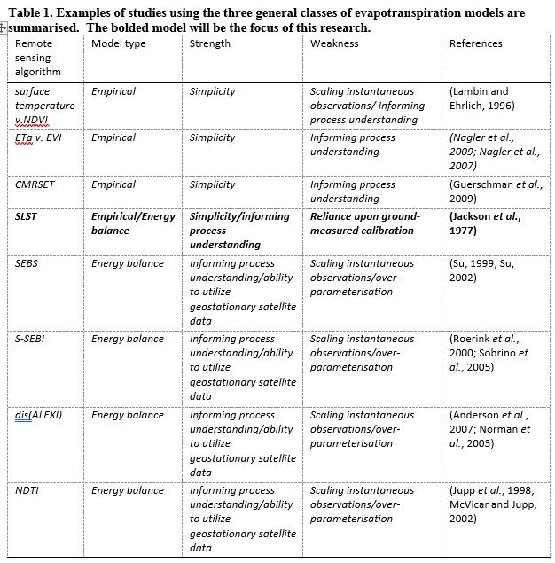
Spatio-temporal modelling of actual evapotranspiration (ETa)
Hydrological management and research require estimation of spatially and temporally dynamic actual evapotranspiration over large areas and long time spans.
Scaling flux tower data over the vast areas and times where and when it has not been observed could be a parsimonious solution.
This study was conducted to systematically assess the errors involved when using observed flux tower data to scale an energy balance-based approach for continental scale modelling of actual evapotranspiration.
We generalised and extended an energy balance-based scaling method to be able to utilise multiple covariates as first- or higher-order.

Slide 3
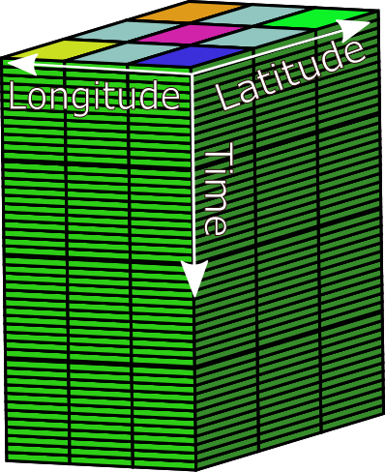
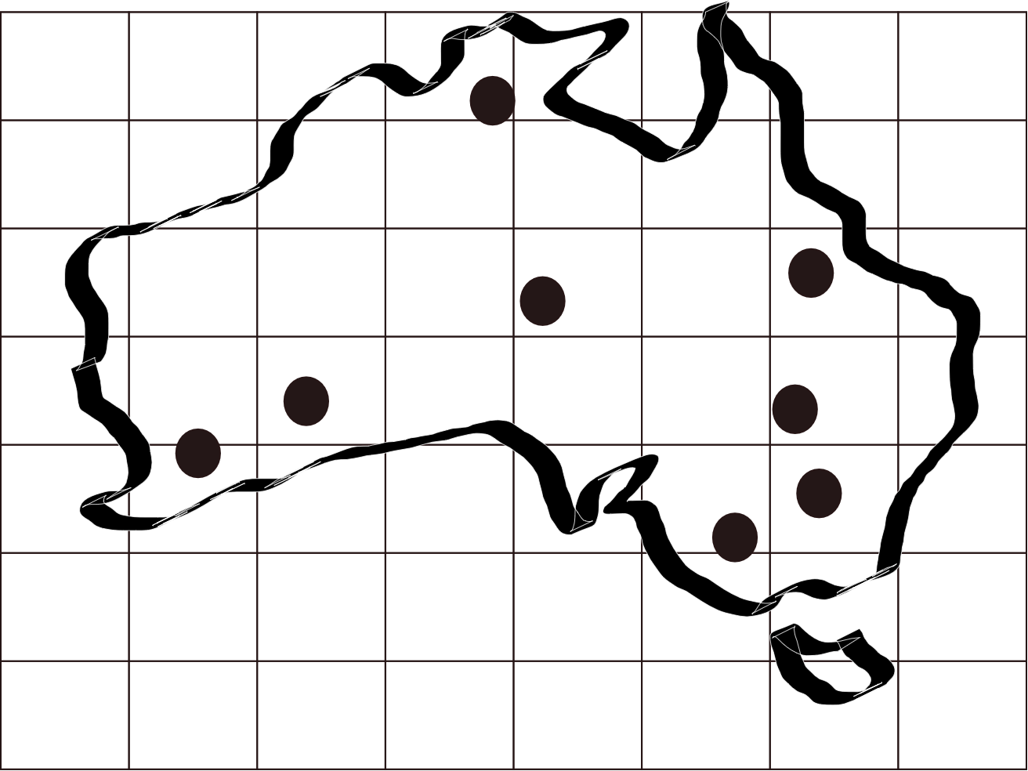
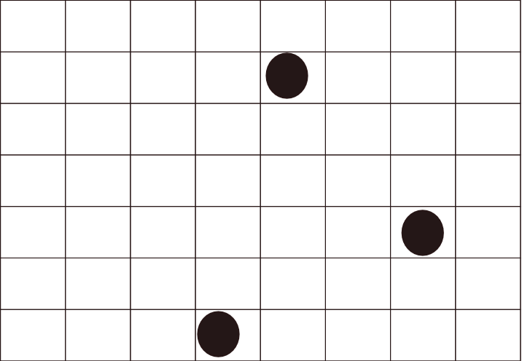
Spatio-temporal modelling
Context
X is a data array that is ‘continuous’ spatially and temporally. X is known as a covariate, a predictor variable, an independent variable. (A raster)
y is a data array that is discontinuous spatially and/or temporally (e.g., measured ETa from a sparse flux tower network). y may be from ground measurement and is known as ground truth, training data, dependent variable. (Traditionally a point vector dataset with t.s. information)
x is a subset of X, defined at the locations and times y was measured.
Y is a data array that is ‘continuous’ spatially and temporally. Y is a theoretical construct. It is what we want to model (e.g., monthly ETa over all of Australia).
X
x
X, x, y, and Y can be represented by a spatio-temporal data cube.

Slide 4
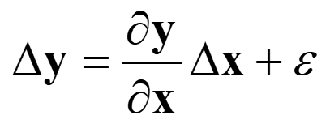
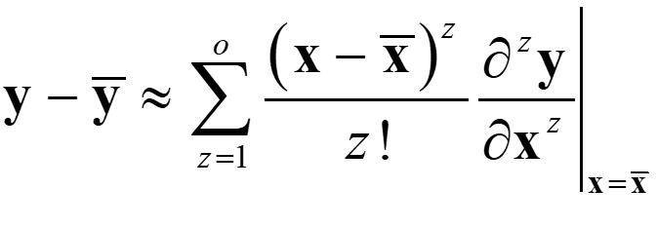
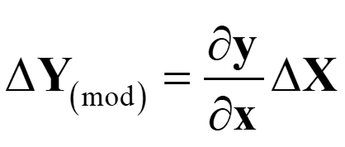
Generalised an energy balance-based scaling method
Spatio-temporal General Linear Model (GLM)
Energy Balance
When run to first-order with one covariate, it is a specific form of linear regression; run to first-order with multiple covariates, it is a specific multiple linear regression, and run to higher than first order (single or multiple covariates) it is a specific polynomial regression). The specifics handle the Taylor-series stuff, which allows the coefficients to be interpreted as partial derivatives.
This form requires only a single matrix pseudo-inversion to define the coefficients (like button) - but to represent the full distribution space accurately, the number of coefficients required grows exponentially in the x dimension (sad face emoji). Also, using higher order functions can result in pretty wild estimates at the tails of distributions (lol).

Slide 5
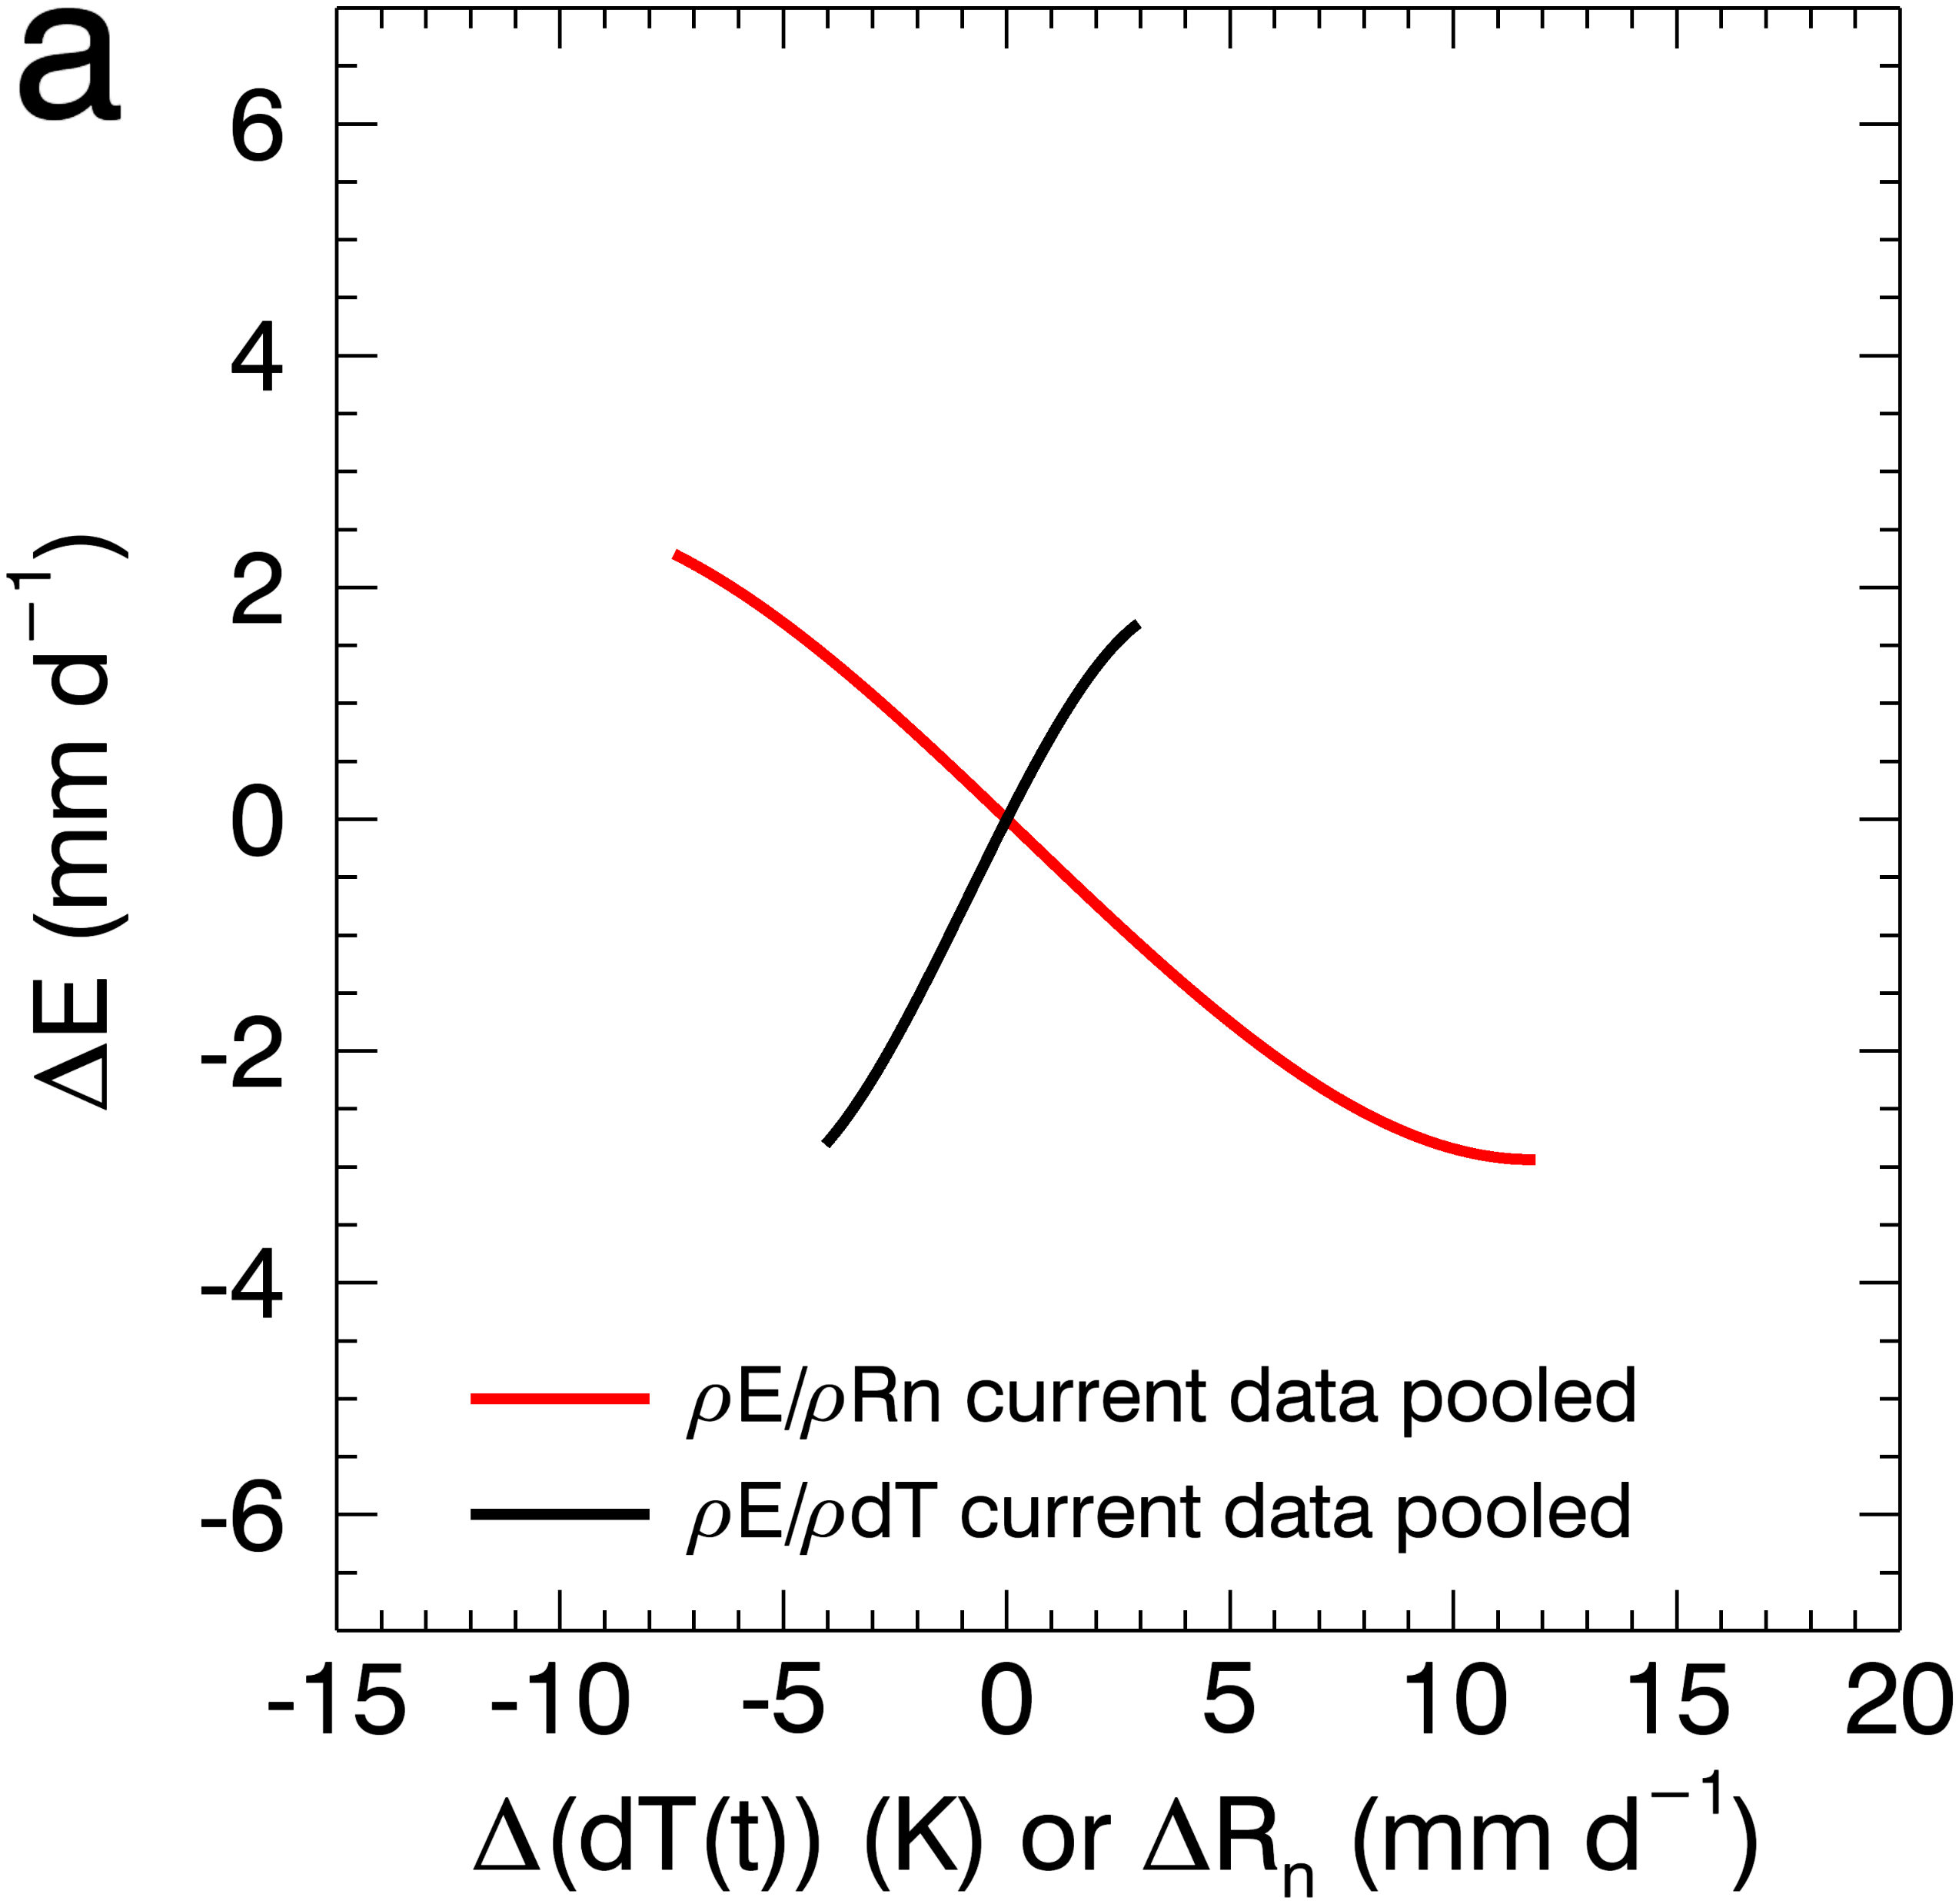
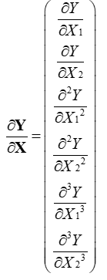
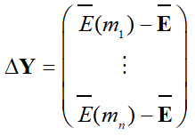
Spatio-temporal modelling of actual Evapotranspiration
The scaling functions look like this:
Estimate heat balance as a GLM; change in actual Evapotranspiration (ETa) based on two covariates: (1) a model of net radiation (Randall Donohue et al); and (2) MODIS LST less BAWAP Ta;
Partial derivatives are scaling factors allowing for prediction of ETa based on change in Energy and Temperature.
The matrices look like this:
(1) Partial derivatives are scaling functions; (2) with Taylor-series expansion the partials can be modelled to > 1st order; (3) we estimate partial derivatives by minimising OLS; (4) apply the partial derivatives defined from ‘little x and little y’ data to ‘big X’, we can estimate ‘big Y’.

Slide 6
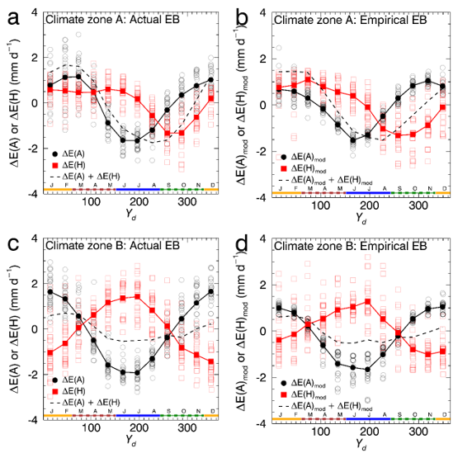
Spatio-temporal modelling of actual Evapotranspiration
Allows for estimation of the total change in ETa (dashed black), the change in ETa due to changes in available energy (solid black), and the change in ETa due to changes in sensible heat flux (red) with remote sensing.
The dynamics above are interesting and show R.S./met variables get the basic heat balance components right.
Notes:
Importantly, the red line is high (black line is low) under energy-limited conditions and the red line is low (black line is high) under water-limited conditions. Assessment of the dynamics allows for something akin to a spatially and temporally dynamic budyko relationship, except the description of the water stress is based on remote sensing data that observes real changes on the ground. This is an exciting opportunity for assessing soil water storage changes and actual water use dynamics.

Slide 7
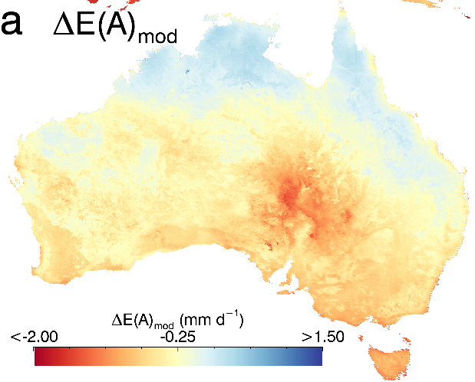
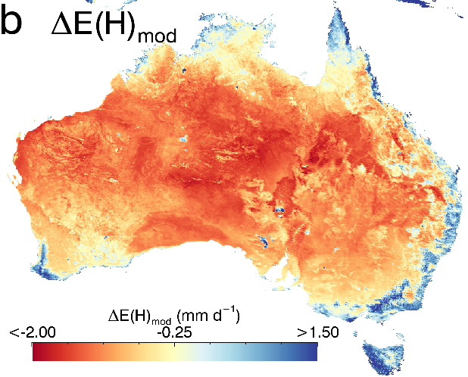
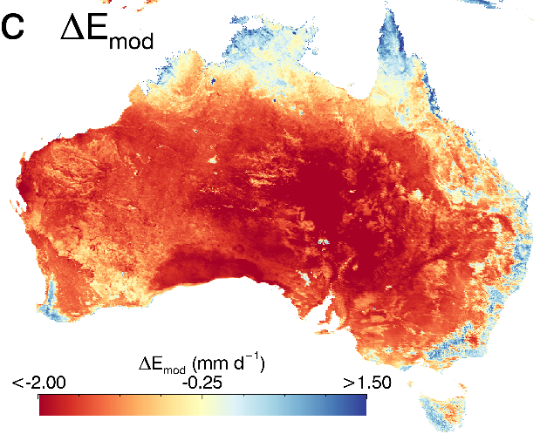
Spatio-temporal modelling of actual Evapotranspiration
The attribution of ETa dynamics due to estimated changes in available energy, those due to estimated changes in sensible heat flux, and those due to changes in both available energy and sensible heat flux can be represented spatially as well (as long-term temporal means above)
Notes:
The spatial representation of the actual evaporation components are shown. The blue values on the middle map indicates high evaporation due to sensible heat flux, which indicates those select areas that are not severely water-limited. The third map is formed by adding the first two.

Slide 8
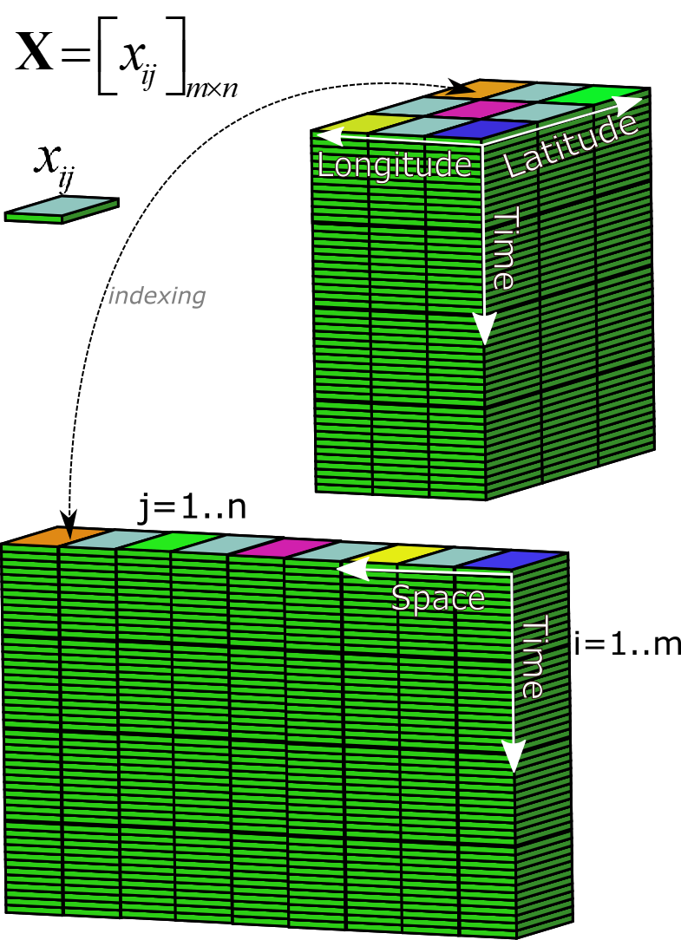
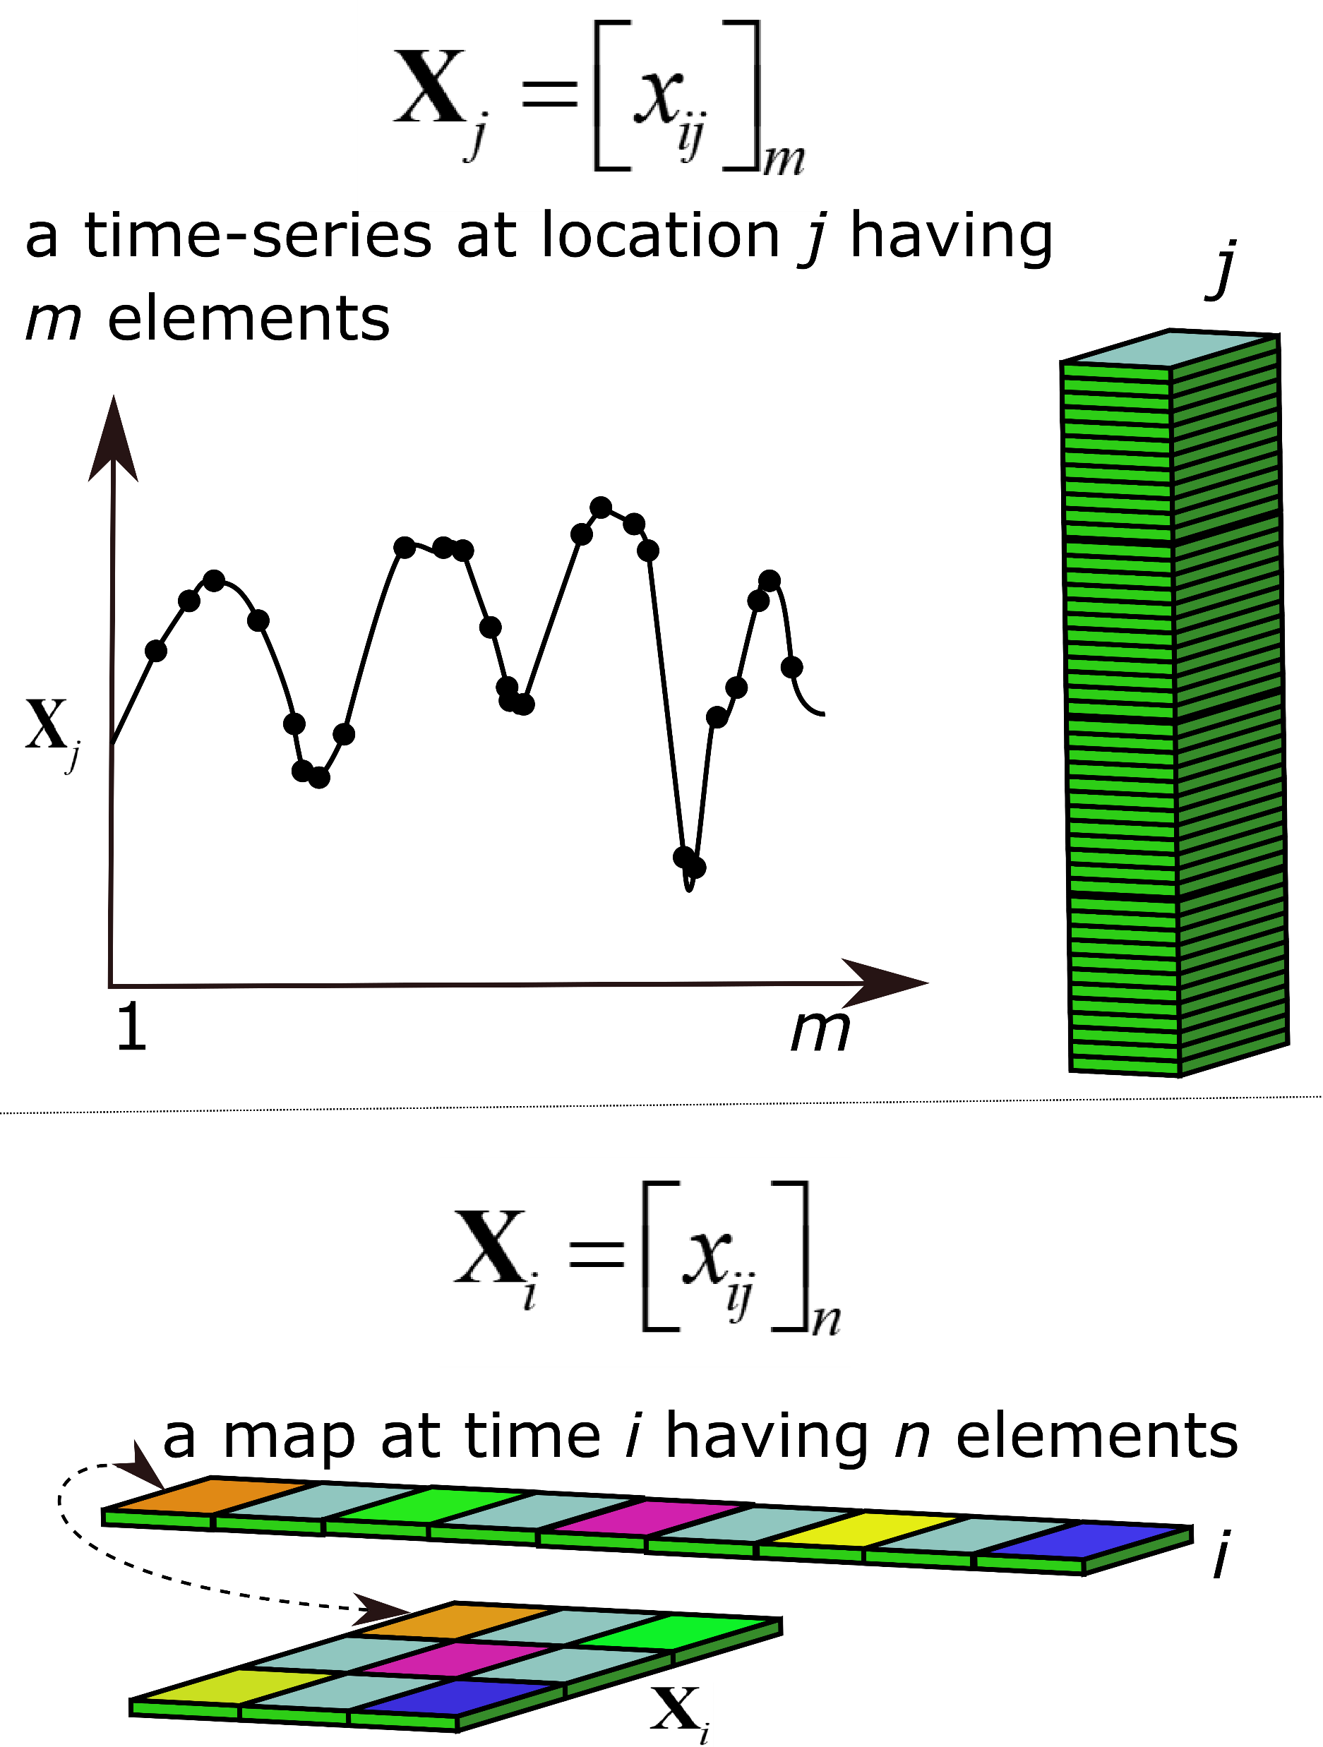
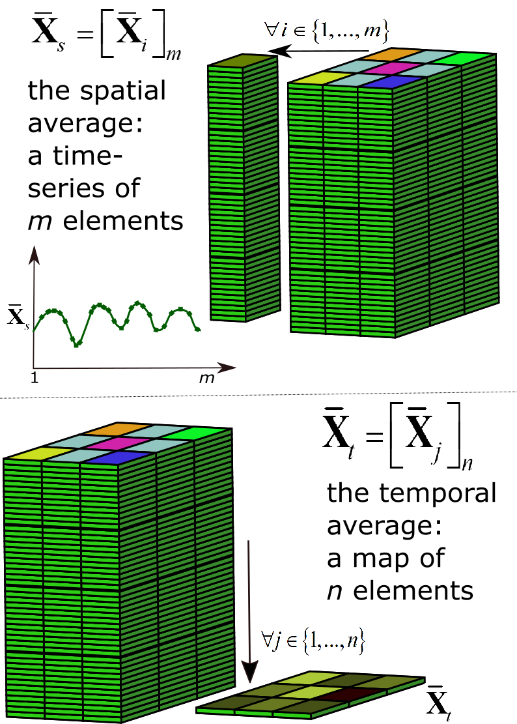
Isolating spatial component and temporal component
Based on a very clever GRL paper by Fubao Sun and Mike Roderick, et. al (2010), which partitions the overall variance of a spatio-temporal dataset into spatial variance and temporal variance, using standard ANOVA technique
Format the array to have 1d space, 1d time
Variability as a time series or a map?
Average space to become time series or
average time to become a map?

Slide 9
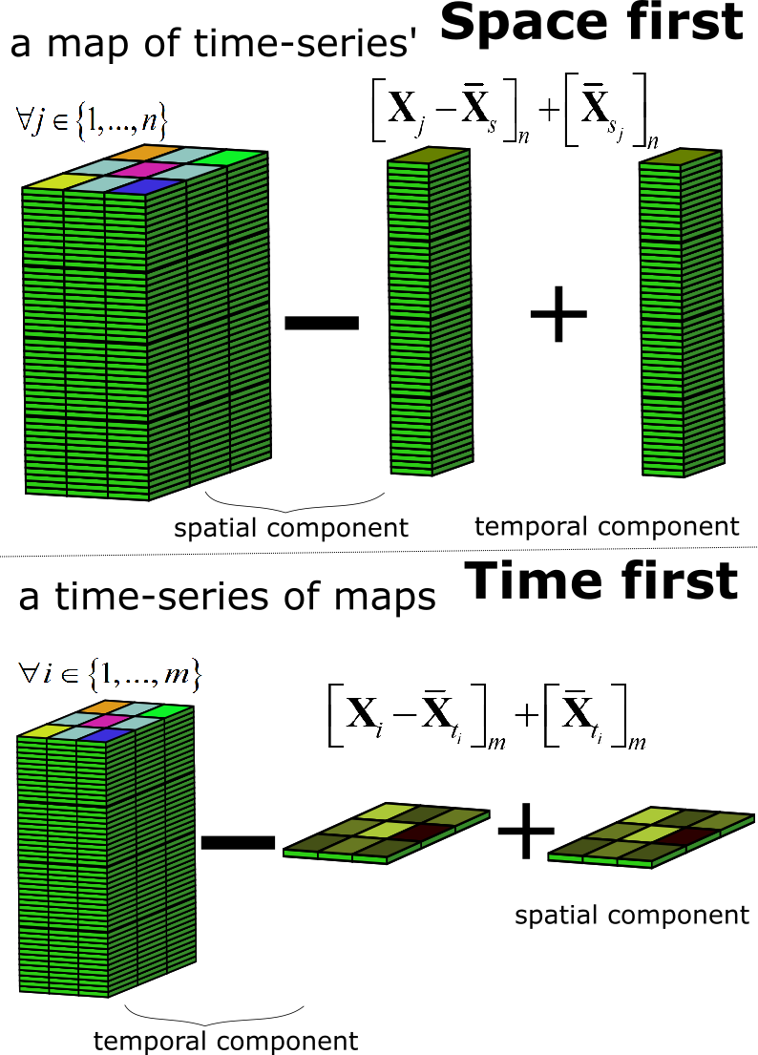
Isolating spatial component and temporal component
Blending Landsat and MODIS data
Two different approaches to isolate space and time based on which component is averaged first.
Scaling observed ETa
from flux towers to
all Australia

Slide 10
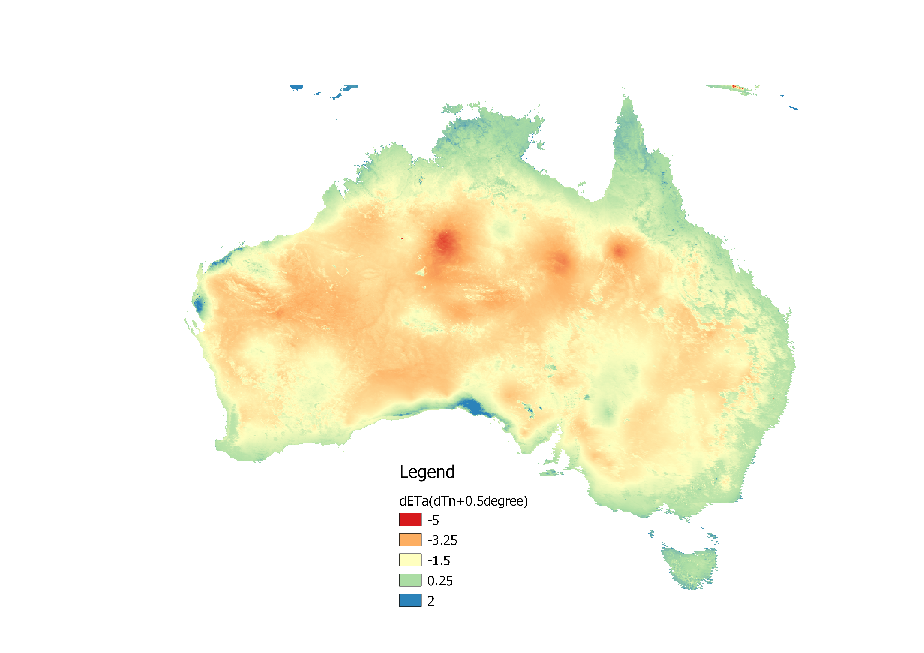
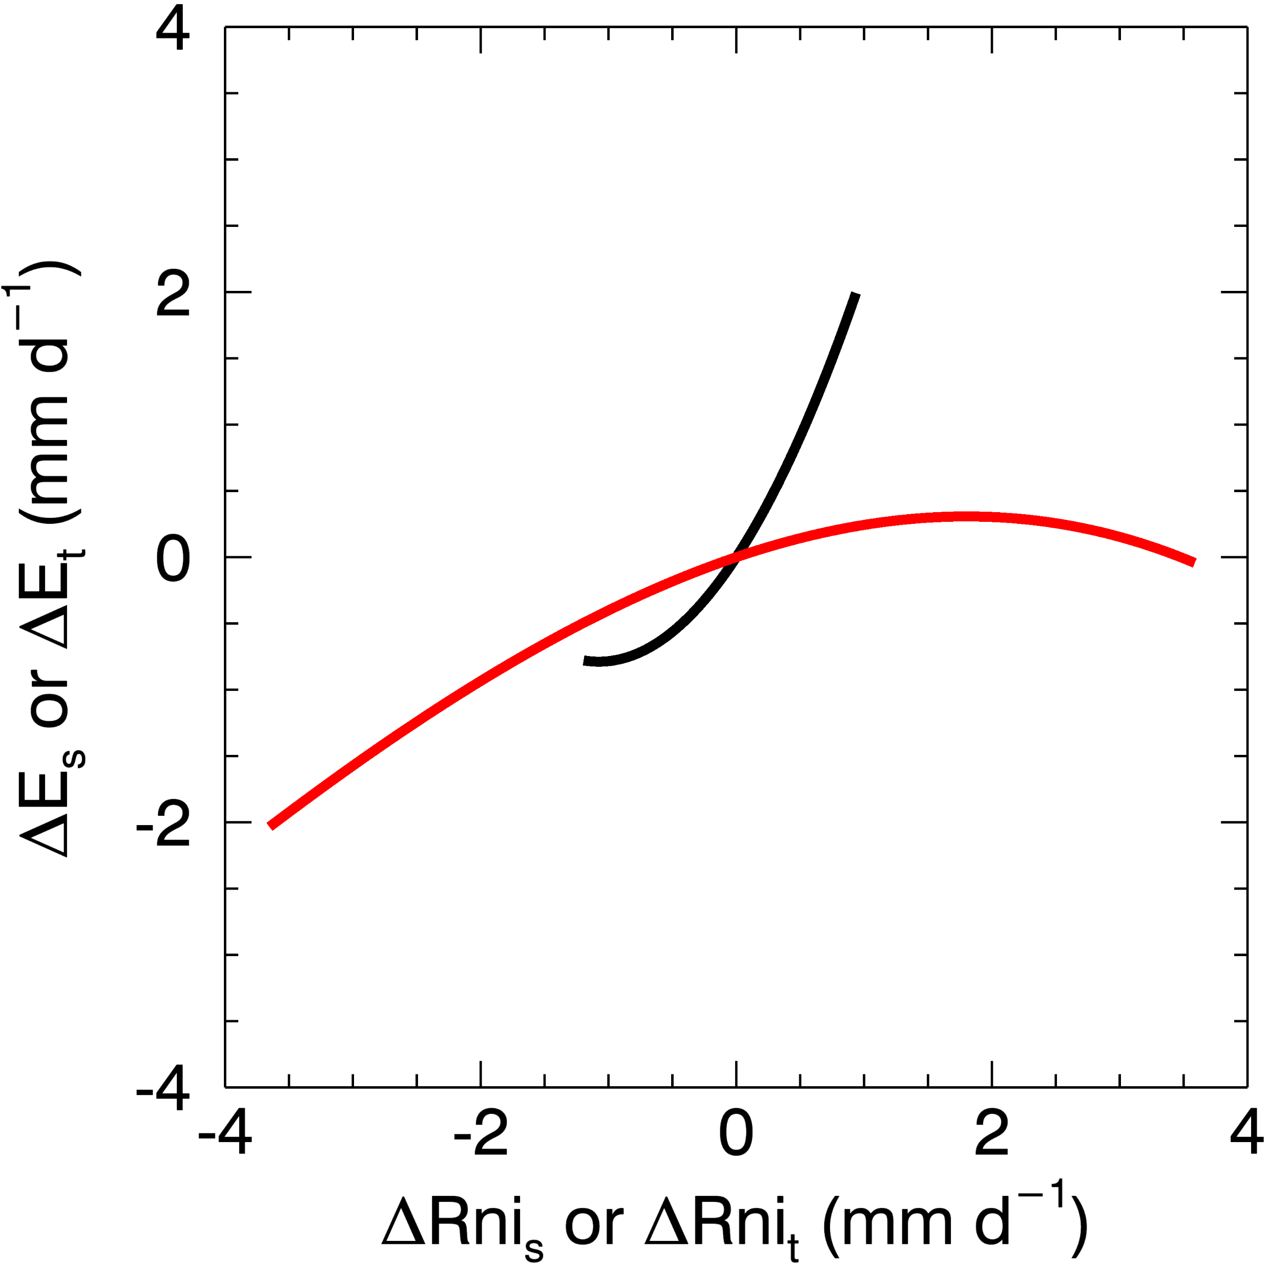
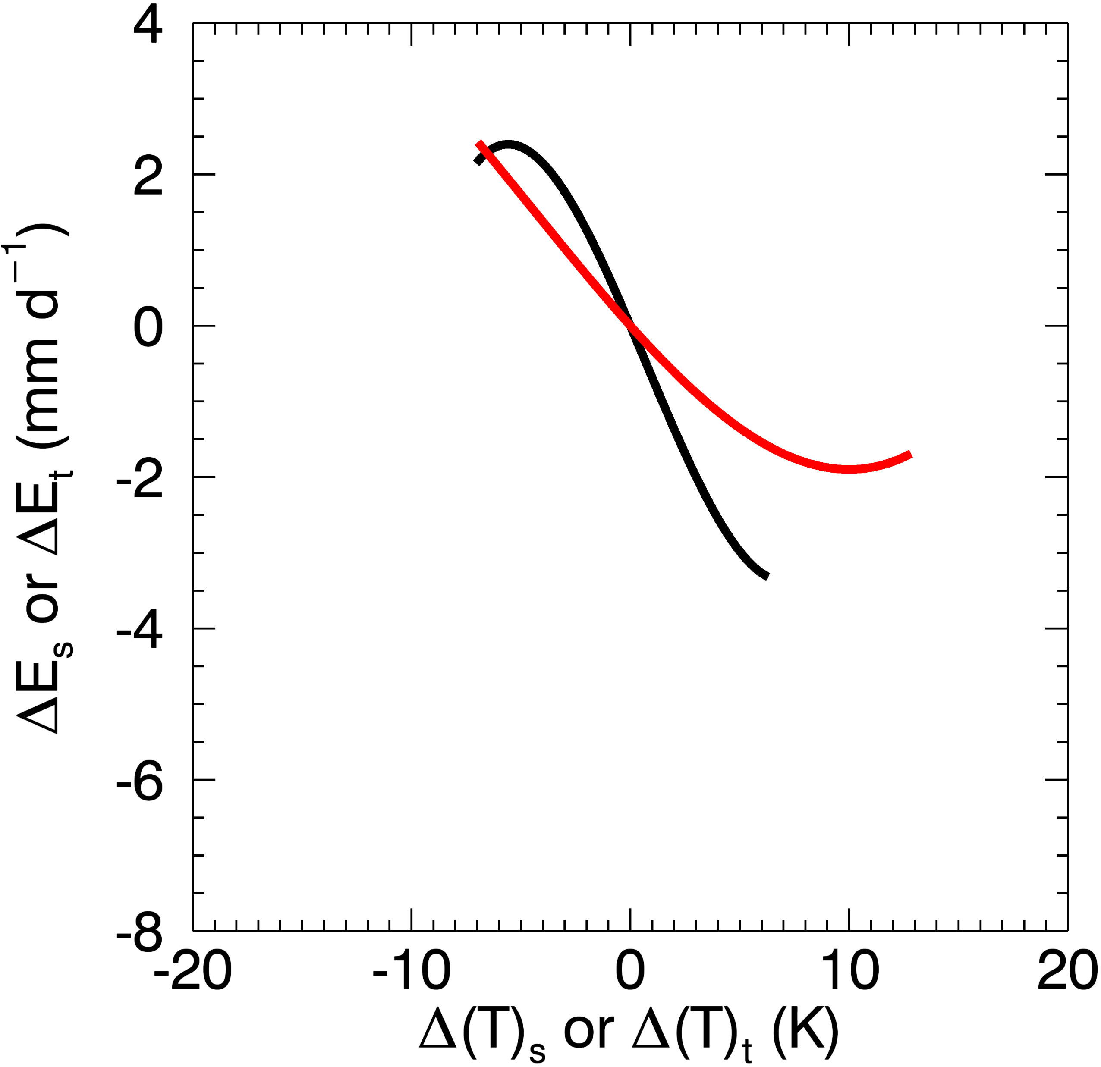
Isolating spatial component and temporal component
Scenario: Increase in dT of + 0.5 degree what is the impact on ETa?
Spatial function
Temporal function
Two different approaches to isolate space and time based on which component is averaged first.
Increases discriminating ability and accuracy.
Separate spatial and temporal functions are useful.
It is a needed framework for spatio-temporal analysis, adding rigour and a clearer pathway for experimental design.
mm d⁻¹
Error assessment using DINGO dataset of ~30 flux towers
Validation dataset = all observations at Tumbarumba, Calperum, and Howard Springs

Slide 11
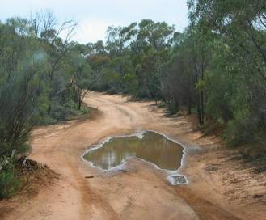
Tom.VanNiel@csiro.au
THANK YOU

